Slide 1
Military Tactical Planning
Notes:
Say:
"Tactical planning is not what most people associate with cyber. Today we apply the same rigor used for a small-unit operation to cyberspace."
Show:
The two-panel image; emphasize "same process, different terrain."
Do:
Ask: "Who has seen a team use a tactical planning process before a cyber operation?" Use responses to calibrate examples.
Image Prompt:
No image required for this slide.
Ask (Q):
Who has seen a team use a tactical planning process before a cyber operation?
Expected Response (A):
Facilitation only. Use responses to calibrate examples.

Slide 2
Intro Video
https://www.youtube.com/watch?v=y0C5ShzJnhQ
https://www.youtube.com/watch?v=y0C5ShzJnhQ
Notes:
Say:
"Play the clip, then start the lesson."
Show:
The video on the slide.
Do:
Play it once. Move on when it ends.
Image Prompt:
No image required for this slide.
Ask (Q):
What is the operational point of the clip?
Expected Response (A):
Facilitation only. Use the answers to start the lesson.

Slide 3
Lesson Objectives
By the end of this lesson you will be able to:
Understand the process of conducting Tactical Planning, recall and apply each component/process given a scenario.
Map Tactical Tasks to cyberspace operations
Define METT-TC
Create a SALUTE report on an enemy
Conduct DRAW-D analysis, implement each step during planning.
Conduct friendly and enemy Terrain Analysis applying the components of OCOKAW.
Notes:
Say:
"Applying tactical planning to cyber is not one action. It is a sequence of analyses and products. These objectives describe the complete chain."
Show:
Reveal the objectives in pipeline order.
Do:
Ask students to mark which process is new to them; revisit the poll during the recap.
Image Prompt:
No image required for this slide.
Ask (Q):
Which process on this list is new to you?
Expected Response (A):
Facilitation only. Revisit the poll during the recap. Do not require a scored answer.

Slide 4
Lesson Objectives Continued
By the end of this lesson you will be able to:
Identify an adversary Center of Gravity and Critical Vulnerabilities.
Determine an adversary’s mission.
Determine the Enemy’s Most Likely Course of Action.
Recall the components of an effective Exploitation Plan.
Develop a Scheme of Maneuver, Fire Support Plan, and Tasks
Notes:
Say:
Walk Lesson Objectives Continued in the order it is written.
Show:
The points on the slide.
Do:
Ask one student to restate the point in their own words.
Image Prompt:
No image required for this slide.
Ask (Q):
What is the operational point of this slide?
Expected Response (A):
A restatement of the on-slide point. Do not require a scored answer.

Slide 5
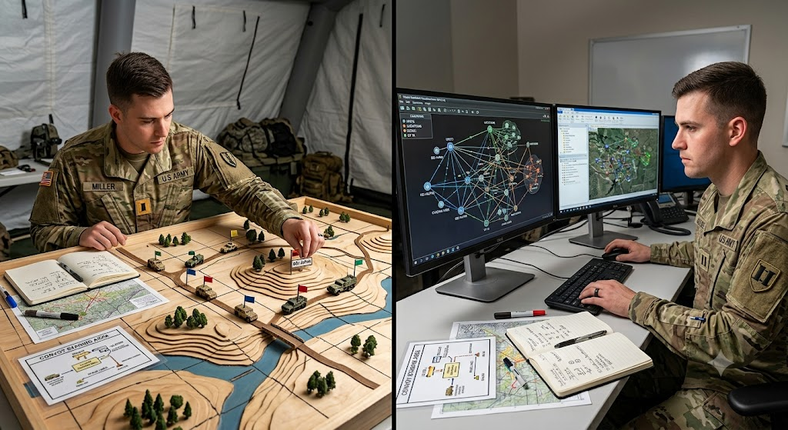
Introduction to Military Tactical Planning
Notes:
Say:
Walk Introduction to Military Tactical Planning in the order it is written.
Show:
The figure on the slide.
Do:
Ask one student to restate the point in their own words.
Image Prompt:
No image required for this slide.
Ask (Q):
What is the operational point of this slide?
Expected Response (A):
A restatement of the on-slide point. Do not require a scored answer.

Slide 6
Introduction to Military Tactical Planning
Tactical planning is typically not associated with cyber or information operations and rather is normally reserved for those conducting tactical ground operations.
Considering this fact, it may seem unusual in a training centered around cyberspace to dive into topics like convoys and tactical ground operations.
Remember that as uniformed service members, the better you can contextualize your actions within military planning fundamentals, the better you can communicate and transition between warfighting domains.
“War is nothing but a duel on a larger scale…imagining a pair of wrestlers. Each tries through physical force to compel the other to do his will.” – Carl Von Clausewitz
Notes:
Say:
"Tactical planning is not what most people associate with cyber. It is what a small unit leader does when they are about to roll a five-truck convoy five miles up the road. We are going to take that same rigor and apply it to cyberspace, because we are uniformed service members and cyber is a warfighting domain."
Show:
The two-panel image; emphasize "same process, different terrain."
Do:
Acknowledge it may feel disorienting to not be talking about cyber for the first hour. Tell them that is deliberate: "If you are uncomfortable right now, that is the point. We are resetting the frame."
Image Prompt:
No image required for this slide.
Ask (Q):
Why are we not starting with industry DFIR frameworks?
Expected Response (A):
Steer toward doctrine first and fluent translation between cyberspace and other warfighting domains. Discomfort in the first hour is deliberate.

Slide 7
Introduction to Military Tactical Planning
Mindset to adopt throughout this training:
  You are conducting operations against the enemy
  You are defending your terrain
  Enemies are attacking your terrain
  You are responding by striking back against their terrain
Notes:
Say:
"Repeat this after me, out loud. It is going to feel weird. It should. Most of you have spent your careers being told that your job stops at the perimeter. That framing is about to shift."
Show:
The four sentences, one at a time.
Do:
Have the room read the four lines aloud, write them down, and leave them visible for the week. If someone smirks, stop and address it — the tone of the course depends on everyone taking this seriously.
Image Prompt:
No image required for this slide.
Ask (Q):
Repeat the four mindset lines. Why does this framing feel different from hunt work at the perimeter?
Expected Response (A):
Steer toward operations against the enemy and striking back against their terrain. If someone smirks, stop and address it.

Slide 8
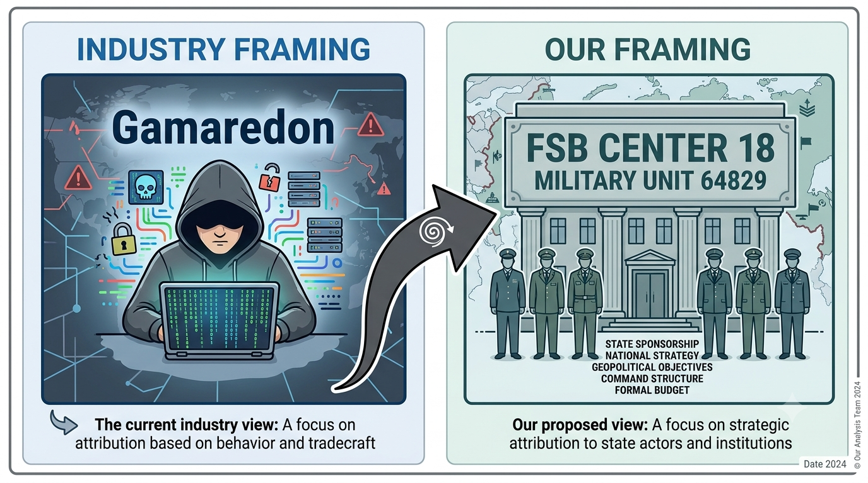
Introduction to Military Tactical Planning
Shifting the Mindset
Notes:
Say:
"Industry calls the cluster Gamaredon. The unit we plan against is FSB Center 18, Military Unit 64829. That shift changes assumptions, attribution, and support relationships."
Show:
The framing panel on the slide.
Do:
Leave the panel up. You will use it again when the worked FSB example starts.
Image Prompt:
No image required for this slide.
Ask (Q):
What changes when the planning unit is FSB Center 18 rather than the industry cluster name?
Expected Response (A):
Assumptions, attribution, and support relationships change. The panel is the framing for the worked example.

Slide 9
Tactical Tasks
Notes:
Say:
Walk Tactical Tasks in the order it is written.
Show:
The figure on the slide.
Do:
Ask one student to restate the point in their own words.
Image Prompt:
No image required for this slide.
Ask (Q):
What is the operational point of this slide?
Expected Response (A):
A restatement of the on-slide point. Do not require a scored answer.

Slide 10
Tactical Tasks
What are tactical tasks?
  Essentially, they are actions that can be taken to accomplish a mission. There are four orientations of tactical tasks:
    Enemy-Oriented
    Terrain-Oriented
    Friendly-Oriented
    Population-Oriented
  Let’s explore orientations and tasks a little deeper…
Notes:
Say:
Walk Tactical Tasks in the order it is written.
Show:
The points on the slide.
Do:
Ask one student to restate the point in their own words.
Image Prompt:
No image required for this slide.
Ask (Q):
What is the operational point of this slide?
Expected Response (A):
A restatement of the on-slide point. Do not require a scored answer.

Slide 11
Tactical Tasks
What are Enemy-Oriented Tactical Tasks?
  Enemy-Oriented Tactical Tasks are actions directed at an enemy force with the aim of creating an effect.
  They are specific, standardized verbs used in combat orders to clearly communicate the desired effect a friendly unit is to have on the enemy.
  These tasks are fundamental to offensive operations and are used to create a clear, shared understanding of the mission
Notes:
Say:
Walk Enemy-Oriented Tactical Tasks in the order it is written.
Show:
The points on the slide.
Do:
Ask one student to restate the point in their own words.
Image Prompt:
No image required for this slide.
Ask (Q):
What is the operational point of this slide?
Expected Response (A):
A restatement of the on-slide point. Do not require a scored answer.

Slide 12
Tactical Tasks
Enemy-Oriented Tactical Tasks:
  Each Enemy-Oriented tactical task that has an asterisk next to it is a tactical task with multiple classifications and applications.
Ambush | Attack by Fire | Block | Breach*
Bypass | Canalize | Contain | Corrupt
Deceive | Defeat | Degrade | Deny
Destroy | Disrupt | Exploit | Feint
Fix | Influence* | Interdict | Isolate
Neutralize | Penetrate | Reconnoiter* | Support by Fire
Suppress
Notes:
Say:
Walk Tactical Tasks in the order it is written.
Show:
The points on the slide.
Do:
Ask one student to restate the point in their own words.
Image Prompt:
No image required for this slide.
Ask (Q):
What is the operational point of this slide?
Expected Response (A):
A restatement of the on-slide point. Do not require a scored answer.

Slide 13
Tactical Tasks
What are Friendly-Oriented Tactical Tasks?
  Friendly-Oriented Tactical Tasks are actions where the primary focus is on the movement or support of a friendly force.
  Unlike enemy-oriented tasks that focus on destroying or defeating an adversary, these tasks are centered on the friendly force's status and relationship to the enemy, terrain, or another friendly unit.
  For example, convoy missions are typically friendly-oriented, with the main goal being to deliver personnel or supplies to a destination.
Notes:
Say:
Walk Tactical Tasks in the order it is written.
Show:
The points on the slide.
Do:
Ask one student to restate the point in their own words.
Image Prompt:
No image required for this slide.
Ask (Q):
What is the operational point of this slide?
Expected Response (A):
A restatement of the on-slide point. Do not require a scored answer.

Slide 14
Tactical Tasks
Friendly-Oriented Tactical Tasks:
Cover | Disengage | Displace
Exfiltrate | Follow and Assume | Follow and Support
Guard | Protect | Screen
Notes:
Say:
Walk Tactical Tasks in the order it is written.
Show:
The points on the slide.
Do:
Ask one student to restate the point in their own words.
Image Prompt:
No image required for this slide.
Ask (Q):
What is the operational point of this slide?
Expected Response (A):
A restatement of the on-slide point. Do not require a scored answer.

Slide 15
Tactical Tasks
What are Terrain-Oriented Tactical Tasks?
  Terrain-Oriented Tactical Tasks are actions focused on controlling or influencing the physical environment.
  The primary purpose of these tasks is to seize, retain, or deny the enemy access to specific terrain or a geographic area.
  Unlike tasks that focus on a friendly or enemy force, the terrain itself is the objective.
Notes:
Say:
"A deliberate defense: I have been given the terrain task of 'control' in order to protect friendly forces — that's a friendly task. While doing that, with the enemy nearby, I am also told to reconnoiter them — that is either a terrain or enemy task. Three tactical tasks, three orientations, one mission."
Show:
The figure on the slide.
Do:
Think-pair-share: students define the orientations, discuss whether tasks can cross them, then offer one cyber example for each. Capture the strongest examples. Treat population-oriented tasks briefly; do not force a cyber analogy.
Image Prompt:
No image required for this slide.
Ask (Q):
Define the four orientations. Can a mission hold more than one? Give one cyber example that is not forced.
Expected Response (A):
Enemy, terrain, friendly, population. Tasks can flow between orientations. Population-oriented examples stay brief; do not force a cyber analogy.

Slide 16
Tactical Tasks
Terrain-Oriented Tactical Tasks:
      Each Terrain-Oriented tactical task that has an asterisk next to it is a tactical task with multiple classifications and applications.
Breach* | Clear | Control
Cordon | Occupy | Reconnoiter*
Retain | Secure | Seize
Notes:
Say:
Walk Tactical Tasks in the order it is written.
Show:
The figure on the slide.
Do:
Ask one student to restate the point in their own words.
Image Prompt:
No image required for this slide.
Ask (Q):
What is the operational point of this slide?
Expected Response (A):
A restatement of the on-slide point. Do not require a scored answer.

Slide 17
Tactical Tasks
What are Population-Oriented Tactical Tasks?
  Focus on friendly effort on achieving some sort of condition as it relates to the population within the area of operations.
  Unlike tasks that focus on a friendly or enemy force, the population itself is the objective.
Notes:
Say:
Walk Tactical Tasks in the order it is written.
Show:
The points on the slide.
Do:
Ask one student to restate the point in their own words.
Image Prompt:
No image required for this slide.
Ask (Q):
What is the operational point of this slide?
Expected Response (A):
A restatement of the on-slide point. Do not require a scored answer.

Slide 18
Tactical Tasks
Population-Oriented Tactical Tasks:
      Each Population-Oriented tactical task that has an asterisk next to it is a tactical task with multiple classifications and applications.
Advise | Assess the Pop. | Assist
Build/Restore infrx. | Contain* | Control*
Coord with Civ Auth | Cordon* | Enable Civ Auth
Exclude | Influence* | Occupy*
Reconnoiter* | Secure* | Train
Transition to Civ Control
Notes:
Say:
Walk Tactical Tasks in the order it is written.
Show:
The figure on the slide.
Do:
Ask one student to restate the point in their own words.
Image Prompt:
No image required for this slide.
Ask (Q):
What is the operational point of this slide?
Expected Response (A):
A restatement of the on-slide point. Do not require a scored answer.

Slide 19
Tactical Tasks
As you have seen, each orientation has task verbs associated with it, and some of these verbs overlap. You can flow between the orientation of task or simultaneously have multiple tactical tasks spanning across those orientations.
Let’s look at an example of what this means…
Notes:
Say:
"The technical action is not the tactical task. Choose the task that best expresses the required effect while accounting for the adversary's likely reaction."
Show:
The scenario and the tactical-task reference.
Do:
Give teams **10 minutes**, then ask each for one task-purpose statement. Grade the reasoning, not agreement on one verb.
Image Prompt:
No image required for this slide.
Ask (Q):
What is the most appropriate tactical task and purpose for the port-terminal C2 scenario, and why are plausible alternatives less suitable?
Expected Response (A):
Grade the reasoning, not agreement on one verb. The technical action is not the tactical task. Nested drill: B01.M12.

Slide 20
Tactical Tasks
Consider someone who has a deliberate defense and has dug-in trenches because they have been given the terrain-oriented tactical task of Retain in order to “protect” friendly forces (and remember that protect is normally a friendly-oriented tactical task).
While controlling and protecting, there may be adversaries in the vicinity so this person may also be tasked with reconnoitering the adversary (reconnoiter being both a terrain-oriented AND an enemy-oriented tactical task).
  In this scenario, you can see three tactical tasks overlapping their orientations and classifications. This is where task prioritization becomes important.
Notes:
Say:
"A deliberate defense: I have been given the terrain task of 'control' in order to protect friendly forces — that's a friendly task. While doing that, with the enemy nearby, I am also told to reconnoiter them — that is either a terrain or enemy task. Three tactical tasks, three orientations, one mission."
Show:
The figure on the slide.
Do:
Think-pair-share: students define the orientations, discuss whether tasks can cross them, then offer one cyber example for each. Capture the strongest examples. Treat population-oriented tasks briefly; do not force a cyber analogy.
Image Prompt:
No image required for this slide.
Ask (Q):
Define the four orientations. Can a mission hold more than one? Give one cyber example that is not forced.
Expected Response (A):
Enemy, terrain, friendly, population. Tasks can flow between orientations. Population-oriented examples stay brief; do not force a cyber analogy.

Slide 21
Identify Tasks (Mission Analysis)
1. Identify Tasks: Deconstruct the order from higher echelons into:
  Specified Tasks: Explicitly stated in the order.
  Implied Tasks: Not explicitly stated but necessary for mission accomplishment.
2. Conduct Purpose Analysis: Determine the "why" behind the mission.
    What is the desired end state? “In order to….”
    What is the commander's overall intent? Higher’s endstate
Notes:
Say:
"Mission analysis starts with a task from higher. If they were good about it, the task includes one of the tactical tasks we just discussed. If not, you have to extract one. Either way, you owe your troops a clean statement of what and why. In this course, the why is always the same: make our adversary's life expensive."
Show:
The bullets; linger on "impose cost" and "generate options for pursuit."
Do:
Ask: "Our adversaries have operated unopposed in cyberspace for how long?" Let the room answer. Use it to frame the cost-imposition mindset.
Image Prompt:
No image required for this slide.
Ask (Q):
Our adversaries have operated unopposed in cyberspace for how long? What is the commander's intent in this course?
Expected Response (A):
Facilitation only on the first question. Intent: impose cost and generate options for pursuit.

Slide 22
Tactical Tasks
The example on the previous slide can happen in cyberspace just as easily.
A cyber operator could be tasked with reconnoitering the adversary, and then reconnoitering the adversary as they conduct operations in their terrain, and then reconnoitering the adversary’s terrain. Once they conduct sufficient recon of the terrain, the operator can act on it by destroying it, disrupting it, etc.
Notes:
Say:
Walk Tactical Tasks in the order it is written.
Show:
The points on the slide.
Do:
Ask one student to restate the point in their own words.
Image Prompt:
No image required for this slide.
Ask (Q):
What is the operational point of this slide?
Expected Response (A):
A restatement of the on-slide point. Do not require a scored answer.

Slide 23
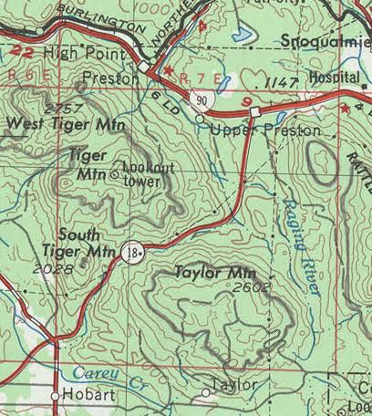
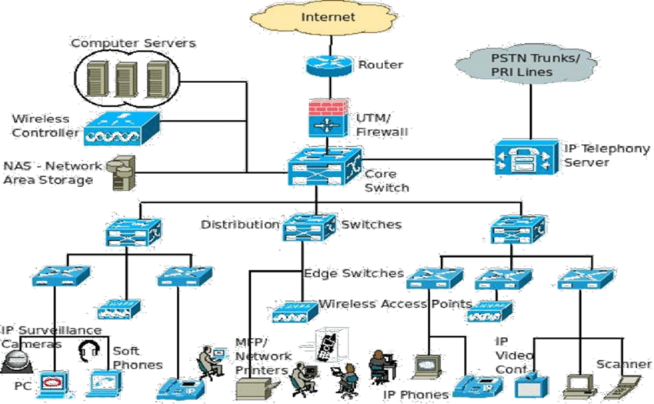

Two Maps
Notes:
Say:
"Here is the first group exercise. You will get a handout of tactical task definitions from Operational Terms and Graphics. Your job is to argue which tasks apply to cyber, which apply with modification, and which do not apply at all. There is no single right answer — the argument matters more than the verdict. We are also going to do a follow-up exercise later this week where we map ATT&CK, D3FEND, and ENGAGE techniques onto these tactical tasks — so keep your verdicts; we will come back to them."
Show:
The figure on the slide.
Do:
Break into groups of 3-4. Timebox: **20 minutes** of group work + **10 minutes** of back-brief. Collect verdicts on the whiteboard and tell the class you will return to them during the ATT&CK/D3FEND/ENGAGE block.
Image Prompt:
No image required for this slide.
Ask (Q):
Which tactical tasks apply to cyber, which apply with modification, and which do not apply at all?
Expected Response (A):
No single right answer — the argument matters more than the verdict. Keep verdicts for the later ATT&CK / D3FEND / ENGAGE callback. Nested drill: B01.M11.

Slide 24
Tactical Task Activity
Background
Friendly Forces are preparing for an amphibious entry into a contested regional port. The port's local logistics network and maritime operating systems have been partially compromised by an adversary threat group.
To support the physical landing, your team has established active logical access to the port's network topology. The Commander demands that every cyber defense or offense plan you pitch be expressed using standard doctrinal tactical tasks. Using non-doctrinal cyber jargon (e.g., "we will patch it" or "we will run an exploit") is unauthorized.
For the following your group must:
  Identify the single most appropriate doctrinal tactical task from Appendix C.
  Justify why that specific task is the correct choice over closely related tasks.
  Detail the technical cyber actions required to execute the task.
Goal:
Translate technical maneuvers into military tasks.
Notes:
Say:
Walk Tactical Task Activity in the order it is written.
Show:
The points on the slide.
Do:
Ask one student to restate the point in their own words.
Image Prompt:
No image required for this slide.
Ask (Q):
What is the operational point of this slide?
Expected Response (A):
A restatement of the on-slide point. Do not require a scored answer.

Slide 25
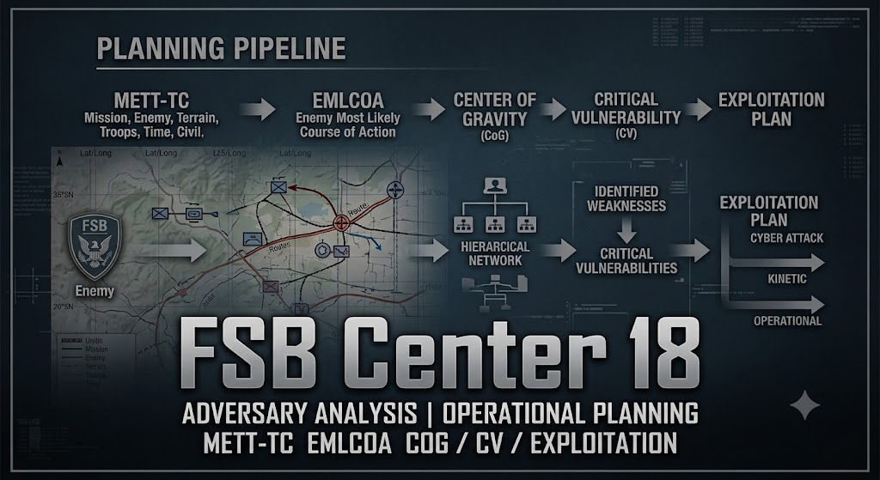
Tactical Planning Process
Notes:
Say:
Walk Tactical Planning Process in the order it is written.
Show:
The figure on the slide.
Do:
Ask one student to restate the point in their own words.
Image Prompt:
No image required for this slide.
Ask (Q):
What is the operational point of this slide?
Expected Response (A):
A restatement of the on-slide point. Do not require a scored answer.

Slide 26
Tactical Planning Process
  BAMCIS provides a foundational framework for military leadership and planning at the tactical level.
Acronym | Step | Description
B | Begin the Planning | Starts upon receipt of a mission. Involves an initial assessment using the METT-TC framework.
A | Arrange Reconnaissance | Determine information gaps and plan to fill them through reconnaissance and surveillance.
M | Make Reconnaissance | Execute the reconnaissance plan to confirm or deny assumptions about the enemy and terrain.
C | Complete the Planning | Finalize the operational plan based on updated information gathered during reconnaissance.
I | Issue the Order | Clearly and concisely communicate the finalized plan to subordinate leaders.
S | Supervise | Oversee the execution of the plan, making adjustments as the situation evolves.
Notes:
Say:
Walk Tactical Planning Process in the order it is written.
Show:
The points on the slide.
Do:
Ask one student to restate the point in their own words.
Image Prompt:
No image required for this slide.
Ask (Q):
What is the operational point of this slide?
Expected Response (A):
A restatement of the on-slide point. Do not require a scored answer.

Slide 27
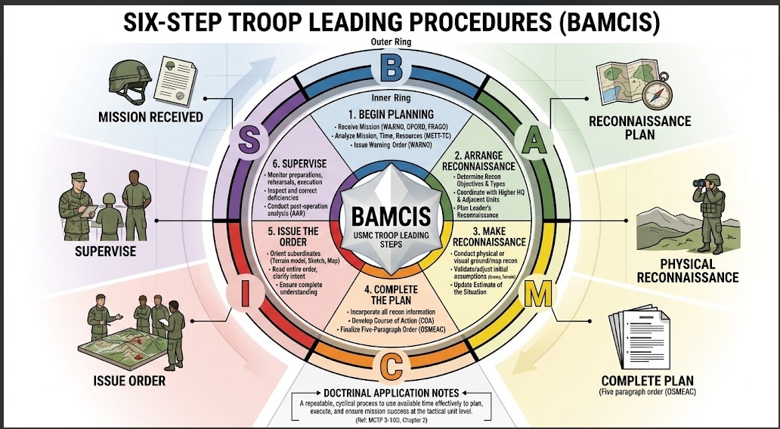
Tactical Planning Process
Notes:
Say:
Walk the BAMCIS detail on the slide.
Show:
The figure on the slide.
Do:
Ask one student to restate the point in their own words.
Image Prompt:
No image required for this slide.
Ask (Q):
What is the operational point of this slide?
Expected Response (A):
A restatement of the on-slide point. Do not require a scored answer.

Slide 28
Tactical Planning Process
  Estimate of the Situation: METT-TC
  METT-TC is the primary tool used to Begin the Planning. It is a systematic analysis of the key variables in any tactical situation.
Acronym | Factor | Cyberspace Considerations
M | Mission | Analyze specified and implied tasks from higher echelons. Understand the “why” (commander’s intent).
E | Enemy | Analyze adversary composition, disposition, strength, and capabilities.
T | Troops & Fire Support | Catalog organic and attached assets, skills, tools, and higher-level support.
T | Terrain & Weather | Analyze the digital and physical environment from both friendly and adversary perspectives.
T | Time/Space/Logistics | Assess time available, operational area (logical/physical), and logistical constraints.
C | Civilian Considerations | Evaluate potential impacts on non-combatant populations and infrastructure.
Notes:
Say:
"Most of a second lieutenant's planning lives in the first two steps — Begin and Arrange. Begin is three things: assess time, do a first-pass METT-TC, and draft a tentative plan. The tentative plan is just three questions — what do I know, what do I think, what am I going to do. The moment you put that on paper, you will discover the questions you cannot answer. Those become your RFIs. Arrange Recon is where people over-simplify. It is not 'send scouts out.' It is **all** of the coordination — legal, intel, host unit, adjacent cyber units, the physical-logical-persona maneuver required for your team to be in position to execute."
Show:
The table on the slide.
Do:
Ask the room to name one RFI you would generate from a first-pass METT-TC against any APT from the earlier group exercise. Capture two answers on the whiteboard.
Image Prompt:
No image required for this slide.
Ask (Q):
Name one RFI you would generate from a first-pass METT-TC against any APT from the earlier group exercise.
Expected Response (A):
Capture two answers on the board. RFIs emerge when the tentative plan answers what do I know / think / going to do.

Slide 29
Mission Analysis
Notes:
Say:
Walk Mission Analysis in the order it is written.
Show:
The title on the slide.
Do:
Ask one student to restate the point in their own words.
Image Prompt:
No image required for this slide.
Ask (Q):
What is the operational point of this slide?
Expected Response (A):
A restatement of the on-slide point. Do not require a scored answer.

Slide 30
Mission Analysis
Core Task:
  To understand the unit's mission and the commander's intent.
Process:
  1. Identify Tasks: Deconstruct the order from higher echelons into:
    Specified Tasks: Explicitly stated in the order.
    Implied Tasks: Not explicitly stated but necessary for mission accomplishment.
  2. Conduct Purpose Analysis: Determine the "why" behind the mission.
    What is the desired end state?
    What is the commander's overall intent?
Notes:
Say:
Walk Mission Analysis in the order it is written.
Show:
The points on the slide.
Do:
Ask one student to restate the point in their own words.
Image Prompt:
No image required for this slide.
Ask (Q):
What is the operational point of this slide?
Expected Response (A):
A restatement of the on-slide point. Do not require a scored answer.

Slide 31
Mission Analysis
Deny or degrade the FSB Center 18's ability to collect intelligence from Network X in order to preserve friendly freedom of maneuver in cyberspace.
Notes:
Say:
Walk Mission Analysis in the order it is written.
Show:
The points on the slide.
Do:
Ask one student to restate the point in their own words.
Image Prompt:
No image required for this slide.
Ask (Q):
What is the operational point of this slide?
Expected Response (A):
A restatement of the on-slide point. Do not require a scored answer.

Slide 32
Enemy Analysis
Notes:
Say:
Walk Enemy Analysis in the order it is written.
Show:
The points on the slide.
Do:
Ask one student to restate the point in their own words.
Image Prompt:
No image required for this slide.
Ask (Q):
What is the operational point of this slide?
Expected Response (A):
A restatement of the on-slide point. Do not require a scored answer.

Slide 33
Enemy Analysis: SALUTE
  Enemy Analysis - Composition, Disposition & Strength
  A SALUTE report provides a clear picture of the adversary.
Acronym | Factor | Cyberspace Considerations
S | Size | Nation-state, criminal group, or individual? Assess via estimated monetary backing, manpower, and technical capability (e.g., use of SI).
A | Activity | What are they doing? Map adversary action to a standardized framework like MITRE ATT&CK®.
L | Location | Where are they operating? Differentiate between physical location (Country X) and logical location (Cloud provider in Country Y).
U | Unit | Who are they? Identify specific threat actor groups and their affiliation (e.g., foreign intelligence or military unit).
T | Time | When was the activity observed? Recency is critical to assessing current threat.
E | Equipment | What tools are they using? Identify specific malware, C2 frameworks, and exploit kits.
Notes:
Say:
"SALUTE captures composition, disposition, and strength. In cyber, size is usually a proxy for money. Activity is your MITRE ATT&CK mapping. Location has two layers — physical and logical — and you have to articulate both. Unit matters because we are not hunting 'Fancy Bear'; we are hunting the GRU."
Show:
The SALUTE diagram.
Do:
Give the class one example SALUTE line for each letter using a well-known APT — pick one they will all recognize.
Image Prompt:
No image required for this slide.
Ask (Q):
Give one SALUTE line for each letter using a well-known APT.
Expected Response (A):
Size as money/workforce; activity as ATT&CK; location physical and logical; unit as the actual intel/military entity; time observed; equipment as tooling.

Slide 34
Enemy Analysis: SALUTE
Practical Application: SALUTE Analysis Group Exercise
Objective: Apply the SALUTE framework to a real-world adversary.
Instructions:
  Each team will be provided a threat intelligence report on FSB Center 18
  Conduct a SALUTE analysis based on the information in the report.
    Document any RFIs that are likely needed to be submitted
  Prepare a 2-minute brief to present your findings to the class.
Notes:
Say:
Walk Enemy Analysis: SALUTE in the order it is written.
Show:
The points on the slide.
Do:
Ask one student to restate the point in their own words.
Image Prompt:
No image required for this slide.
Ask (Q):
What is the operational point of this slide?
Expected Response (A):
A restatement of the on-slide point. Do not require a scored answer.

Slide 35
Enemy Analysis: SALUTE
Size:
Activity:
Location:
Unit:
Time:
Equipment:
Notes:
Say:
Walk Enemy Analysis: SALUTE in the order it is written.
Show:
The points on the slide.
Do:
Ask one student to restate the point in their own words.
Image Prompt:
No image required for this slide.
Ask (Q):
What is the operational point of this slide?
Expected Response (A):
A restatement of the on-slide point. Do not require a scored answer.

Slide 36
Enemy Analysis: How they Operate
Enemy Analysis - Capabilities & Limitations
Initial Access: Spearphishing (malicious LNK/HTA attachments) and weaponized USB drives (PteroLNK).
Data Exfiltration: Stealing documents, browser credentials (PteroSteal), cookies (PteroCookie), and data from Signal (PteroSig) and Telegram (PteroGram).
Persistence & Lateral Movement: Weaponized Office templates (PteroDoc, PteroTemplate) and extensive use of scheduled tasks.
Notes:
Say:
"DRAW-D is evidence plus bounded inference. The observed mission is collection. Do not make destructive action the EMLCOA merely because root access makes it technically possible."
Show:
Link each conclusion to the report evidence or label it an assumption.
Do:
Teams receive **15 minutes** to challenge one DRAW-D conclusion and write the RFI that would resolve it.
Image Prompt:
No image required for this slide.
Ask (Q):
Challenge one DRAW-D conclusion and write the RFI that would resolve it.
Expected Response (A):
Do not make destructive action the EMLCOA merely because root access makes it possible. Observed mission is collection.

Slide 37
Enemy Analysis: DRAW-D
Enemy Analysis - Capabilities & Limitations
Acronym | Capability | Cyberspace Considerations
D | Defend | Can they defend their infrastructure and access? What defensive tools (e.g., EDR, NGAV) are in place?
R | Reinforce | Can they escalate privileges, deploy additional tools, or establish redundant C2 channels?
A | Attack | What is their capability to conduct offensive effects operations from their current posture?
W | Withdraw | Can they exfiltrate and remove their presence? Is their access too valuable to abandon? Under what conditions will they withdraw (e.g., upon any detection)?
D | Delay | Can they disrupt our analysis or response efforts (e.g., through data wiping, misdirection)?
Notes:
Say:
Walk Enemy Analysis: DRAW-D in the order it is written.
Show:
The points on the slide.
Do:
Ask one student to restate the point in their own words.
Image Prompt:
No image required for this slide.
Ask (Q):
What is the operational point of this slide?
Expected Response (A):
A restatement of the on-slide point. Do not require a scored answer.

Slide 38
Enemy Analysis: DRAW-D
DRAW-D assesses the adversary's capabilities in the context of the operation. For each element, analyze:
  What is their capability to perform the action?
  What limits their ability to perform it?
  Under what conditions will they perform it?
Notes:
Say:
"After SALUTE you move to DRAW-D: capabilities and limitations. For each action, answer three questions — can they do it, what limits them, and under what conditions will they do it? Withdraw is the one I want you to really sit with. If your adversary withdraws the instant they sense us, reconnoiter as a mission is gone."
Show:
The DRAW-D bullets; spend extra time on **Withdraw**.
Do:
Pose the scenario: "Your tasking is 'reconnoiter.' Your adversary's withdrawal condition is 'any anomaly in normal traffic.' What does that do to your scheme of maneuver?" Let the room answer.
Image Prompt:
No image required for this slide.
Ask (Q):
Your tasking is reconnoiter. The adversary withdraws on any traffic anomaly. What does that do to your scheme of maneuver?
Expected Response (A):
Steer toward DRAW-D withdraw conditions killing a reconnoiter mission if they flee on first anomaly.

Slide 39
Enemy Analysis: DRAW-D
Practical Application: DRAW-D Analysis Group Discussion
Objective: Evaluate an adversary's capabilities and limitations.
Instructions:
  Using the same APT group from the SALUTE exercise, discuss the following question:
    "Based on your analysis, what is this actor's most significant limitation, and under what conditions would they be forced to withdraw from a compromised network?“
  Be prepared to share your group's assessment.
Notes:
Say:
"A big part of this is learning to recognize the questions you cannot answer from a public report. Those questions become RFIs. Your intel shop needs you to be explicit about what you need — 'tell me more about the adversary' is not a request they can action."
Show:
The same reports from Slide 11.
Do:
Timebox: **15 minutes**. Capture RFIs on the whiteboard; return to them at the end of the day.
Image Prompt:
No image required for this slide.
Ask (Q):
Where did you have to guess on DRAW-D, and what RFI would make that guess actionable?
Expected Response (A):
Guesses become RFIs. 'Tell me more about the adversary' is not actionable. Nested drill: B01.M14.

Slide 40
Enemy Analysis: DRAW-D
Defend:
Reinforce:
Attack:
Withdraw:
Delay:
Notes:
Say:
Walk Enemy Analysis: DRAW-D in the order it is written.
Show:
The points on the slide.
Do:
Ask one student to restate the point in their own words.
Image Prompt:
No image required for this slide.
Ask (Q):
What is the operational point of this slide?
Expected Response (A):
A restatement of the on-slide point. Do not require a scored answer.

Slide 41
Friendly Forces Analysis
Notes:
Say:
Walk Friendly Forces Analysis in the order it is written.
Show:
The points on the slide.
Do:
Ask one student to restate the point in their own words.
Image Prompt:
No image required for this slide.
Ask (Q):
What is the operational point of this slide?
Expected Response (A):
A restatement of the on-slide point. Do not require a scored answer.

Slide 42
Friendly Forces Analysis
Troops and Fire Support
  This is the friendly counterpart to enemy analysis. Catalog all available resources.
  Organic Assets:
    Personnel: How many operators? What are their specific specialties, skill sets, and certifications?
    Equipment: What hardware, software, and licenses do we own and have available?
    Attachments/Detachments: Who/what has been attached to the unit for this mission (e.g. National Guard element, contractor support)?
    Fire Support (Rear Echelon Support): What reach-back capabilities are available? (e.g. advanced malware analysis, digital forensics, national intelligence agencies).
    Higher and Adjacent Units: What other friendly cyber units are operating in/near this battlespace? What deconfliction measures are required?
Notes:
Say:
"Troops and fire support is the friendly counterpart to SALUTE. It is the audit of what you have to work with. Do not over-report capability — a team with one exploitation analyst does not have 'an exploitation cell.'"
Show:
The four sub-bullets in order.
Do:
Ask the room: "If another cyber unit is also working this target, what breaks first if you do not deconflict?" Accept answers; the right one is "attribution and timeline."
Image Prompt:
No image required for this slide.
Ask (Q):
If another cyber unit is also working this target, what breaks first if you do not deconflict?
Expected Response (A):
Accept answers; the walkthrough names attribution and timeline.

Slide 43
Friendly Forces Analysis
Analysts: 3 Host Analysts, 3 Network Analysts, 1 All-Source Analyst
Operators: 1 Certified Counter-Strike Operator, 1 Certified Malware Analyst
Fire Support: 1 SBO ME in Direct Support
Equipment: Standard complement of tools (network taps, forensic workstations, etc.)
Attachments: None.
Notes:
Say:
"A concrete roster prevents imaginary capabilities from entering the plan. Terrain is not a host inventory; it is what enables or constrains each side's mission."
Show:
Contrast friendly and enemy key terrain.
Do:
Ask teams to identify one resource shortfall and one terrain conclusion that would change the plan.
Image Prompt:
No image required for this slide.
Ask (Q):
Identify one resource shortfall and one terrain conclusion that would change the plan.
Expected Response (A):
A concrete roster prevents imaginary capabilities. Terrain is what enables or constrains each side's mission.

Slide 44
Terrain Analysis: OCOKAW
Notes:
Say:
Walk Terrain Analysis: OCOKAW in the order it is written.
Show:
The points on the slide.
Do:
Ask one student to restate the point in their own words.
Image Prompt:
No image required for this slide.
Ask (Q):
What is the operational point of this slide?
Expected Response (A):
A restatement of the on-slide point. Do not require a scored answer.

Slide 45
Terrain Analysis: OCOKAW
  Terrain analysis must be conducted from both friendly and enemy perspectives. In cyberspace, “terrain” is the network environment.
Acronym | Factor | Friendly Perspective (Blue) | Enemy Perspective (Red)
O | Observation and Fields of Fire | What are our data sources (e.g., NetFlow, PCAP, EDR, Sysmon)? What is our visibility into the environment? | What are their sensors (e.g., Insider access, compromised logging, C2 beacons)? What is their situational awareness?
C | Cover and Concealment | Will our actions be overt or covert? Will we use dedicated obfuscation infrastructure (gray/red space)? | How are they hiding (e.g., matching network baseline, using encryption, “smash and grab” with no stealth)?
O | Obstacles | What barriers hinder data acquisition or scheme of maneuver (e.g., firewalls, encryption, lack of logging)? | What obstacles do they face (e.g., EDR, application allow-listing, MFA, segmentation)?
Notes:
Say:
"Key terrain is where people get lazy. Everyone throws out 'the domain controller.' Sometimes. But your key terrain is whatever enables the mission *the network was built to perform*, and your adversary's key terrain may be different from yours because they are there for a different reason."
Show:
Each bullet; spend longest on Key Terrain.
Do:
Ask: "Name a network you have worked and tell me one piece of key terrain that is **not** a domain controller." Collect three or four answers.
Image Prompt:
No image required for this slide.
Ask (Q):
Name a network you have worked and one piece of key terrain that is not a domain controller.
Expected Response (A):
Key terrain ties to the purpose of the network. Collect three or four answers.

Slide 46
Terrain Analysis: OCOKAW
  Terrain analysis must be conducted from both friendly and enemy perspectives. In cyberspace, “terrain” is the network environment.
Acronym | Factor | Friendly Perspective (Blue) | Enemy Perspective (Red)
K | Key Terrain | What is the critical function/information on this network that enables our mission? Is it not always the Domain Controller. | What terrain is critical for their mission (e.g., a specific database, an ICS controller, credential server)?
A | Avenues of Approach | How can we gain or improve access (e.g., deploying new sensors, using existing credentials)? | How did they get in, and how can they move? Map to MITRE ATT&CK Initial Access Techniques.
W | Weather | Physical weather can affect power and satellite communications, impacting physical infrastructure. | Same considerations as friendly.
Notes:
Say:
"Their key terrain is whatever enables *their* mission. Enumerate it across all three layers of cyberspace — physical, logical, persona. If you only think about key terrain at the logical layer you will miss half of it."
Show:
The three-layer diagram.
Do:
Ask the room to name one piece of enemy key terrain at each layer for the APT their team drew earlier.
Image Prompt:
No image required for this slide.
Ask (Q):
Name one piece of enemy key terrain at each layer — physical, logical, persona — for the APT your team drew.
Expected Response (A):
Steer toward all three layers. Logical-only answers miss half of it.

Slide 47
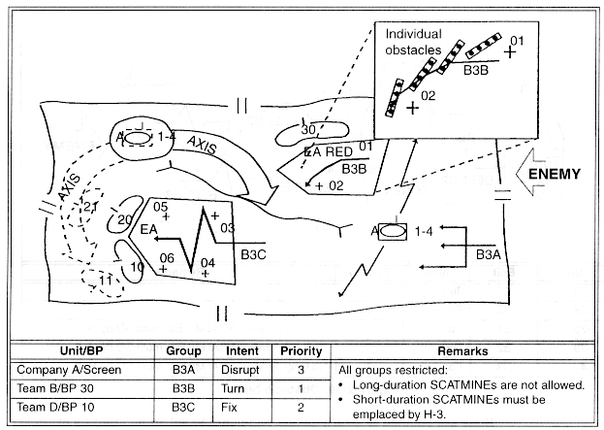
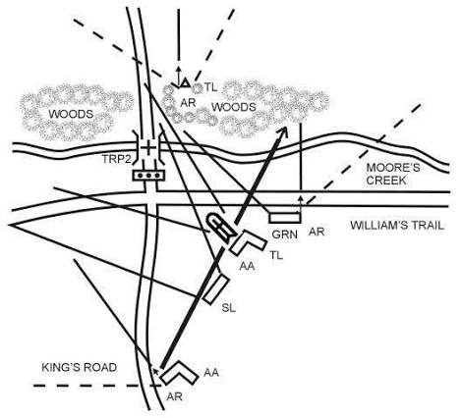
OCOKAW – A Visual
Notes:
Say:
"Yes, I am going to teach OCOKA-W in a cyber class. Some of it is going to bolt on cleanly, some with effort, and some will feel like a stretch. We are going to go through it honestly and mark the places where the analogy breaks."
Show:
The figure on the slide.
Do:
Preview: the next two slides are friendly OCOKA-W and enemy OCOKA-W, back to back.
Image Prompt:
No image required for this slide.
Ask (Q):
Why must OCOKA-W be done from both friendly and enemy perspectives?
Expected Response (A):
Each side's key terrain and avenues differ because their missions differ. The analogy will break in places — mark those honestly.

Slide 48
Terrain Analysis: OCOKAW
Practical Application: OCOKAW Analysis Group Discussion
Objective: Evaluate and document the terrain (network environment) from both the friendly and enemy perspective. Enemy perspective is most important – “turn the map around”
Instructions:
  Continue to use the ESET Whitepaper
  Be prepared to share your group's assessment.
Notes:
Say:
"Yes, I am going to teach OCOKA-W in a cyber class. Some of it is going to bolt on cleanly, some with effort, and some will feel like a stretch. We are going to go through it honestly and mark the places where the analogy breaks."
Show:
The figure on the slide.
Do:
Preview: the next two slides are friendly OCOKA-W and enemy OCOKA-W, back to back.
Image Prompt:
No image required for this slide.
Ask (Q):
Why must OCOKA-W be done from both friendly and enemy perspectives?
Expected Response (A):
Each side's key terrain and avenues differ because their missions differ. The analogy will break in places — mark those honestly.

Slide 49
Terrain Analysis: OCOKAW
Factor | Friendly Perspective | Enemy Perspective
Observation & Fields of Fire
Cover & Concealment
Obstacles
Key Terrain
Avenues of Approach
Weather (Cyber)
Notes:
Say:
"You now have the entire chain, not just vocabulary. The application tests whether your team can build the chain from unfamiliar evidence and leave an ATT&CK-ready handoff."
Show:
Return to the objective slide and confirm each objective was taught or practiced.
Do:
Collect RFIs and begin the Varensk/Lunovia application.
Image Prompt:
No image required for this slide.
Ask (Q):
Can you explain the plan using task and purpose, keeping evidence, assumptions, and RFIs distinct?
Expected Response (A):
Confirm each objective was taught or practiced. Collect RFIs and begin the application.

Slide 50
Time/Space/Logistics & Civilian Considerations
Notes:
Say:
Walk Time/Space/Logistics & Civilian Considerations in the order it is written.
Show:
The points on the slide.
Do:
Ask one student to restate the point in their own words.
Image Prompt:
No image required for this slide.
Ask (Q):
What is the operational point of this slide?
Expected Response (A):
A restatement of the on-slide point. Do not require a scored answer.

Slide 51
Time/Space/Logistics & Civilian Considerations
Time Analysis:
  How much time is available to plan and execute the mission?
  What is the adversary’s timeline?
  How does time zone difference affect adversary vs. friendly operations?
Space Analysis:
  Where is the physical and logical location of the operational environment?
  What Legal and political boundaries apply?
Notes:
Say:
"Time, space, and logistics are where a well-intended plan dies. Time is not just 'when do we execute' — it is the adversary's cadence and our dwell. If they are low-and-slow and our OCONUS window is two weeks, a patient adversary just waits us out. Space is harder than it looks in cyber — all three layers matter. And if the enemy holds more permissive access than you do, that asymmetry drives your maneuver. Logistics is where beautiful plans go to die: infrastructure, tooling, shift coverage, legal queues, and Intelligence Gain/Loss review."
Show:
The three expanded bullets; linger on the **persona** sub-bullet under Space — the permission-asymmetry case is where most plans break.
Do:
Ask: "In your home unit, what is the longest legal-review queue you have ever sat in?" Use the answer to set up the gap between adversary cycle time and friendly decision cycle time.
Image Prompt:
No image required for this slide.
Ask (Q):
In your home unit, what is the longest legal-review queue you have ever sat in?
Expected Response (A):
Facilitation only. Use it to set up the gap between adversary cycle time and friendly decision cycle time.

Slide 52
Time/Space/Logistics & Civilian Considerations
Logistics Analysis:
  Are the required tools and infrastructure available and provisioned?
Civilian Considerations:
  How will operations potentially affect non-combatants?
  Are we operating on critical infrastructure (e.g., power grid, financial services)? What are the potential collateral effects?
Notes:
Say:
"We are not going to hammer ASCOPE and PMESII here. Just know they exist. If your response action touches civilian infrastructure — and in DCO-RA it often does — you owe your commander a civil-considerations read before you execute."
Show:
ASCOPE and PMESII on screen. Scroll through the first page only.
Do:
Tell the class this is an area where they will have to lean on their intel shops and legal review.
Image Prompt:
No image required for this slide.
Ask (Q):
When must civil considerations be surfaced to higher in DCO-RA?
Expected Response (A):
When response action touches civilian infrastructure. This course does not drill ASCOPE/PMESII; lean on intel and legal.

Slide 53
Enemy’s Most Likely Course of Action (EMLCOA)
Notes:
Say:
Walk Enemy’s Most Likely Course of Action (EMLCOA) in the order it is written.
Show:
The points on the slide.
Do:
Ask one student to restate the point in their own words.
Image Prompt:
No image required for this slide.
Ask (Q):
What is the operational point of this slide?
Expected Response (A):
A restatement of the on-slide point. Do not require a scored answer.

Slide 54
EMLCOA
After completing the METT-TC analysis, synthesize the findings to develop a comprehensive assumption of enemy actions. The EMLOCOA answers three questions:
  What is the enemy’s mission?
    Example: Is the enemy trying to achieve a specific tactical task like Exfiltrate sensitive data, or Disrupt a critical service?
  What is the enemy’s current tactical activity?
    Example: Are they staging tools for an attack? Conducting active reconnaissance? Maintaining persistence?
  What are the enemy’s actions on contact?
    Example: How will they react when we take action against them? Will they delete their presence, deploy ransomware, or escalate their activity?
Notes:
Say:
"EMLCOA is not a guess. It is the output of your METT-TC. You have done SALUTE, DRAW-D, and terrain — now you assemble an assumption of the enemy's plan. Think of it as their task, their purpose, and their method of imposing their will. That assumption is what your commander has to counter — and your scheme of maneuver has to counter it in two states: what they are doing right now, and what they will do the moment they realize we are here."
Show:
The three driving questions plus the definition.
Do:
Reminder: "Actions on contact is where DRAW-D pays off. If you skipped DRAW-D, you cannot answer question three. And remember — 'contact' does not mean a gunfight. It means any input from us that changes the enemy's state — a blocked account, a rotated credential, a sudden change in traffic. If they notice, that is contact."
Image Prompt:
No image required for this slide.
Ask (Q):
What three questions drive EMLCOA, and what counts as contact in cyberspace?
Expected Response (A):
Enemy mission; current tactical activity; actions on contact. Contact is any input that alters their state, not only kinetic.

Slide 55
EMLCOA
Practical Application: EMLCOA Analysis Group Discussion
Objective: Evaluate and document the Enemy’s most likely course of action
Instructions:
  Continue to use the ESET Whitepaper to answer the following 3 questions.
    What is the enemy’s mission?
    What is the enemy’s current tactical activity?
    What are the enemy’s actions on contact?
  Be prepared to share your group's assessment.
Notes:
Say:
Walk EMLCOA in the order it is written.
Show:
The points on the slide.
Do:
Ask one student to restate the point in their own words.
Image Prompt:
No image required for this slide.
Ask (Q):
What is the operational point of this slide?
Expected Response (A):
A restatement of the on-slide point. Do not require a scored answer.

Slide 56
EMLCOA
  The enemy’s mission
  The enemy’s current tactical activity
  The enemy’s actions on contact
Notes:
Say:
Walk EMLCOA in the order it is written.
Show:
The points on the slide.
Do:
Ask one student to restate the point in their own words.
Image Prompt:
No image required for this slide.
Ask (Q):
What is the operational point of this slide?
Expected Response (A):
A restatement of the on-slide point. Do not require a scored answer.

Slide 57
Center of Gravity Analysis
Notes:
Say:
Walk Center of Gravity Analysis in the order it is written.
Show:
The points on the slide.
Do:
Ask one student to restate the point in their own words.
Image Prompt:
No image required for this slide.
Ask (Q):
What is the operational point of this slide?
Expected Response (A):
A restatement of the on-slide point. Do not require a scored answer.

Slide 58
Center of Gravity
Center of Gravity (CoG):
  Definition: “That element or capability which allows the enemy to execute their mission or scheme of maneuver successfully.”
  Key Question: Based on the EMLCOA, what is the one thing that is most critical for the enemy’s success?
    Example: The enemy’s CoG is their persistent, undetected access achieved through a combination of stealth and compromised administrative credentials.
Notes:
Say:
"Center of gravity is the thing that, if it goes away, their mission falls apart. In cyber it is rarely one thing. Usually it is a pair — stealth plus admin creds, or a specific piece of tooling plus an unpatched access route."
Show:
The definition; read it verbatim.
Do:
Ask the room: "For the APT your team analyzed — take thirty seconds and write down a candidate center of gravity." Collect two answers.
Image Prompt:
No image required for this slide.
Ask (Q):
For the APT your team analyzed, write a candidate center of gravity in thirty seconds.
Expected Response (A):
Name it specifically. 'Their operators' is not a CG. Cyber CG is often a combination.

Slide 59
Center of Gravity & Critical Capabilities
Critical Capabilities (CCs):
  Definition: “The primary abilities or key actions (often written as verbs like defend, strike, command, or mobilize) that allow a COG to exert power.”
  Key Question: Based on the EMLCOA, what abilities or actions (verbs) does the CoG need?
    Example: The enemy’s CC is maneuver through friendly networks.
Notes:
Say:
"Do not jump from a vague center of gravity directly to a favorite tool. Critical capabilities explain what the COG must do. Critical requirements explain what it needs. The critical vulnerability is the requirement you can actually exploit."
Show:
Work one FSB example: rapid collection requires repeatable execution, document access, and resilient outbound paths; script-heavy execution and observable persistence can become exploitable requirements.
Do:
Ask teams to add one critical capability and one critical requirement beneath their candidate COG before naming a CV.
Image Prompt:
No image required for this slide.
Ask (Q):
Add one critical capability and one critical requirement beneath your candidate COG before naming a CV.
Expected Response (A):
Do not jump from a vague COG to a favorite tool. Trace mission → COG → capability → requirement → vulnerability.

Slide 60
Center of Gravity & Critical Requirements
Critical Requirements (CRs):
  Definition: “The essential conditions, means (things), and specific resources (nouns) needed to keep those capabilities fully operative.”
  Key Question: Based on the EMLCOA, what things (nouns) does the CoG need?
    Example: The enemy’s CR is electrical power.
Notes:
Say:
"Do not jump from a vague center of gravity directly to a favorite tool. Critical capabilities explain what the COG must do. Critical requirements explain what it needs. The critical vulnerability is the requirement you can actually exploit."
Show:
Work one FSB example: rapid collection requires repeatable execution, document access, and resilient outbound paths; script-heavy execution and observable persistence can become exploitable requirements.
Do:
Ask teams to add one critical capability and one critical requirement beneath their candidate COG before naming a CV.
Image Prompt:
No image required for this slide.
Ask (Q):
Add one critical capability and one critical requirement beneath your candidate COG before naming a CV.
Expected Response (A):
Do not jump from a vague COG to a favorite tool. Trace mission → COG → capability → requirement → vulnerability.

Slide 61
Center of Gravity & Critical Vulnerability
Critical Vulnerability (CV):
  Definition: “A vulnerability that, if exploited, will render the enemy’s center of gravity ineffective.”
  Key Question: How can we attack the enemy’s CoG?
    Example: The enemy’s reliance on a single set of credentials for all lateral movement is a critical vulnerability. Removing their access to those credentials will neutralize their CoG.
Notes:
Say:
"Critical vulnerability is the thing you can actually do something about. If your CG was 'stealth plus admin creds,' your CV might be the specific credential set they rely on. Knocking that set out — rotating the passwords, disabling the account — collapses the center of gravity."
Show:
The definition.
Do:
Back to the same teams: "Take the CG you wrote down. Now write a CV that attacks it." Timebox: **5 minutes**.
Image Prompt:
No image required for this slide.
Ask (Q):
Take the CG you wrote down. Write a CV that attacks it.
Expected Response (A):
If they cannot name a CV, the CG is probably too abstract. Nested drill: B01.M16.

Slide 62
The Exploitation Plan
Notes:
Say:
Walk The Exploitation Plan in the order it is written.
Show:
The points on the slide.
Do:
Ask one student to restate the point in their own words.
Image Prompt:
No image required for this slide.
Ask (Q):
What is the operational point of this slide?
Expected Response (A):
A restatement of the on-slide point. Do not require a scored answer.

Slide 63
The Exploitation Plan
Key Question: What specific action(s) will we take to neutralize the enemy’s CoG by exploiting their CV?
  Cyberspace Applications:
    For defensive or “blue space” operations, the MITRE D3FEND framework is a valuable starting point.
    D3FEND provides specific countermeasures that directly map to adversary techniques identified in MITRE ATT&CK.
    Example: If the adversary’s TTP is “Use of Valid Accounts” (ATT&CK), the exploitation plan might involve “Credential Isolation” and “User Account Permissions” (D3FEND).
Notes:
Say:
"The exploitation plan is where planning becomes doing. You name the method you will use to target the CV. In blue-space, our starting vocabulary is MITRE D3FEND **and** MITRE ENGAGE. D3FEND maps directly from ATT&CK to defensive techniques. ENGAGE adds the active, adversary-engagement options — deception, elicitation, shaping the adversary. Fluency in that mapping is what the rest of this planning chain depends on."
Show:
The three-lane ATT&CK → D3FEND + ENGAGE mapping graphic.
Do:
Name the bridge: evidence maps in ATT&CK Navigator, options develop in D3FEND/ENGAGE, and CAD graphs the result.
Image Prompt:
No image required for this slide.
Ask (Q):
Where does the exploitation plan hand off?
Expected Response (A):
ATT&CK/Navigator, D3FEND/ENGAGE, and D3FEND CAD. Starting vocabulary is D3FEND and ENGAGE.

Slide 64
The Exploitation Plan: Putting it all together
Practical Application: Analysis & Group Discussion
Objective: Evaluate and document the Enemy’s most likely course of action
Instructions:
  As a group develop the following:
    Center of Gravity (CoG):
    Critical Vulnerability (CV):
    Exploitation Plan:
  Be prepared to share your group's assessment.
Notes:
Say:
"Another team may argue that persistent access is the COG. That is valid if its evidence chain is stronger. Use competing COGs to teach that the analysis must be explicit, not that one phrase is the answer."
Show:
Compare the speed-of-collection and persistent-access interpretations.
Do:
Ask each team to defend one interpretation using mission, capability, requirement, and vulnerability.
Image Prompt:
No image required for this slide.
Ask (Q):
Defend one COG interpretation using mission, capability, requirement, and vulnerability.
Expected Response (A):
Competing COGs (speed of collection vs persistent access) are valid if the evidence chain is explicit.

Slide 65
The Exploitation Plan: Putting it all together
Center of Gravity (CoG):
Critical Vulnerability (CV):
Exploitation Plan:
Notes:
Say:
"Another team may argue that persistent access is the COG. That is valid if its evidence chain is stronger. Use competing COGs to teach that the analysis must be explicit, not that one phrase is the answer."
Show:
Compare the speed-of-collection and persistent-access interpretations.
Do:
Ask each team to defend one interpretation using mission, capability, requirement, and vulnerability.
Image Prompt:
No image required for this slide.
Ask (Q):
Defend one COG interpretation using mission, capability, requirement, and vulnerability.
Expected Response (A):
Competing COGs (speed of collection vs persistent access) are valid if the evidence chain is explicit.

Slide 66
Scheme of Maneuver, Fire Support Plan, and Tasks
Notes:
Say:
Walk Scheme of Maneuver, Fire Support Plan, and Tasks in the order it is written.
Show:
The points on the slide.
Do:
Ask one student to restate the point in their own words.
Image Prompt:
No image required for this slide.
Ask (Q):
What is the operational point of this slide?
Expected Response (A):
A restatement of the on-slide point. Do not require a scored answer.

Slide 67
Scheme of Maneuver, Fire Support Plan, and Tasks
Scheme of Maneuver:
  Describes how the elements of the exploitation plan will be implemented in a coordinated manner, often through designated phases of the operation.
Fire Support Plan:
  A parallel concept in cyberspace operations.
  Coordinates the use of rear echelon support (e.g., forensics, national agencies) with the tactical actions on the network.
  Ensures actions are deconflicted and mutually supporting.
Tasks:
  Clear, concise tasking assigned to individual operators or teams.
  Crucial for transitioning from a collection of individuals into a synchronized team executing a unified plan.
Notes:
Say:
"The scheme of maneuver phases the exploitation plan. It tells the team when and how it occupies logical, physical, and persona terrain."
Show:
Trace how each phase targets the selected critical vulnerability.
Do:
Ask where the plan must branch if the adversary reinforces instead of maintaining its current behavior.
Image Prompt:
No image required for this slide.
Ask (Q):
Where must the scheme of maneuver branch if the adversary reinforces instead of maintaining current behavior?
Expected Response (A):
Each phase must counter current activity and anticipated actions on contact.

Slide 68
Scheme of Maneuver:
Phase 1:
Phase 2:
Phase 3:
Phase 4:
Phase 5:
Notes:
Say:
Walk Scheme of Maneuver: in the order it is written.
Show:
The points on the slide.
Do:
Ask one student to restate the point in their own words.
Image Prompt:
No image required for this slide.
Ask (Q):
What is the operational point of this slide?
Expected Response (A):
A restatement of the on-slide point. Do not require a scored answer.

Slide 69
Fire Support Plan:
Target Category | Trigger | Organic Action | Rear Echelon Action | Desired Effects
Adversary C2 Infrastructure | Confirmed beaconing from isolated host. | Block outbound traffic; submit RFF. | Conduct active recon & exploit C2 node. | Degrade, Disrupt, Exploit
Adversary Staging Server | Novel payload URL extracted from memory. | Block downloads; submit RFF with URL. | Enumerate/download full toolkit; neutralize server. | Deny, Intelligence Gain
Compromised 3rd-Party Relay | Traffic identified routing through a known proxy. | Null-route traffic; submit RFF. | Coordinate with law enforcement or execute authorized DCORA. | Disrupt
Notes:
Say:
"Cyber fire support is not a list of organizations you might call. It is a trigger-based integration plan tied directly to the scheme of maneuver."
Show:
One worked row from the student deck, then have teams draft their own. Confirmed beaconing from an isolated host: organic block of outbound traffic and a support request; rear echelon recon and exploit of the C2 node; desired effects degrade, disrupt, and exploit. A novel payload URL: block the download and send the URL; rear echelon enumerates the toolkit and neutralizes the server; desired effects deny and intelligence gain. Traffic through a known relay: null-route and submit the request; partner or authorized action against the relay; desired effect disrupt.
Do:
Teams draft one support row and explain how it advances the mission without breaking collection.
Image Prompt:
No image required for this slide.
Ask (Q):
Draft one fire-support row: trigger, organic action, supporting action, desired effect. How does it advance the mission without breaking collection?
Expected Response (A):
FSP is trigger-based integration, not a list of organizations you might call.

Slide 70
Tasks: Organic Asset Tasking
Role | Key Responsibilities
Mission Commander (MC) | Authorize key actions (quarantine, RFF submission), manage risk.
Threat Intel | Provide initial TTPs, analyze extracted tools, update EMLCOA.
Network Analyst (NetOps) | Build/monitor SIEM dashboards, trigger alerts, block C2 IPs locally.
Host Analyst (HostOps) | Deploy EDR, execute immediate host quarantine, conduct live triage.
Notes:
Say:
"A room of specialists becomes a team only when responsibilities, triggers, and purpose are explicit."
Show:
Map these deck roles across the phases. Mission commander authorizes quarantine and support requests and manages risk. Threat intel provides TTPs, analyzes extracted tools, and updates the EMLCOA. Network analyst builds the monitoring view, triggers alerts, and blocks C2 addresses locally. Host analyst deploys endpoint sensors, quarantines the host, and runs live triage.
Do:
Ask teams to identify who owns detection validation, quarantine, indicator dissemination, and support requests.
Image Prompt:
No image required for this slide.
Ask (Q):
Who owns detection validation, quarantine, indicator dissemination, and support requests?
Expected Response (A):
Each role needs task and purpose, phase, trigger, expected evidence, and supervision. Avoid overlapping ownership.

Slide 71
Lesson Summary
The military tactical planning processes (BAMCIS, METT-TC) are highly relevant and directly applicable to cyberspace operations.
Structured analysis (SALUTE, DRAW-D, OCOKAW) is essential for understanding the complex cyber domain.
The goal of planning is to move beyond reaction and proactively impose costs on the adversary.
This is accomplished by identifying the enemy’s Center of Gravity, targeting their Critical Vulnerability, and executing a well-defined Exploitation Plan.
Notes:
Say:
Walk Lesson Summary in the order it is written.
Show:
The points on the slide.
Do:
Ask one student to restate the point in their own words.
Image Prompt:
No image required for this slide.
Ask (Q):
What is the operational point of this slide?
Expected Response (A):
A restatement of the on-slide point. Do not require a scored answer.

Slide 72
Lesson Summary
You should now be able to:
Understand the process of conducting Tactical Planning, recall and apply each component/process given a scenario.
Map Tactical Tasks to cyberspace operations
Define METT-TC
Create a SALUTE report on an enemy
Conduct DRAW-D analysis, implement each step during planning.
Conduct friendly and enemy Terrain Analysis applying the components of OCOKAW.
Notes:
Say:
Walk Lesson Summary in the order it is written.
Show:
The points on the slide.
Do:
Ask one student to restate the point in their own words.
Image Prompt:
No image required for this slide.
Ask (Q):
What is the operational point of this slide?
Expected Response (A):
A restatement of the on-slide point. Do not require a scored answer.

Slide 73
Lesson Summary
You should now be able to:
Identify an adversary Center of Gravity and Critical Vulnerabilities.
Determine an adversary’s mission.
Determine the Enemy’s Most Likely Course of Action.
Recall the components of an effective Exploitation Plan.
Develop a Scheme of Maneuver, Fire Support Plan, and Tasks
Notes:
Say:
Walk Lesson Summary in the order it is written.
Show:
The points on the slide.
Do:
Ask one student to restate the point in their own words.
Image Prompt:
No image required for this slide.
Ask (Q):
What is the operational point of this slide?
What is the tactical planning pipeline we will reuse for the rest of this Block?
How do SALUTE and DRAW-D differ, and what do gaps become?
What is a center of gravity versus a critical vulnerability?
Expected Response (A):
A restatement of the on-slide point. Do not require a scored answer.
## Lesson summary
Tactical planning applies the same small-unit rigor to cyberspace: doctrine first, then cyber translation.
BAMCIS is the teaching spine; the tactical planning process (METT-TC → EMLCOA → COG / CV / exploitation plan → SOM → FSP → tasks) lives in Begin and Complete.
Nested drills practice orientations, task translation, SALUTE, DRAW-D, OCOKA-W, and the COG chain (`B01.M10`–`B01.M17`). Apply the same chain to Varensk/Lunovia and leave an ATT&CK-ready handoff.
Keep evidence, assumptions, and RFIs distinct. Explain the plan with task and purpose.
## Questions and check on learning
METT-TC → EMLCOA → COG / CV / exploitation plan → scheme of maneuver → fire support plan → tasks.
SALUTE is composition, disposition, and strength. DRAW-D is capabilities, limitations, and conditions — especially withdraw. Gaps become RFIs.
CG is what lets the enemy execute the mission; CV is the exploitable lever on that CG. If you cannot name a CV, the CG is too abstract.

Slide 74
Questions?

